Slide 1

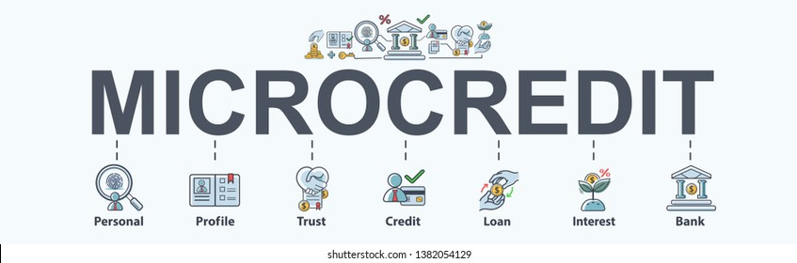
MICRO CREDIT LOAN
NEHA DIXIT

Slide 2

ABOUT MICRO CREDIT LOAN
Micro Credit, a value-added service designed on the premise of “what the consumer needs”, provides ease of access of airtime stock credit to resellers of a telecom operator when they run out of balance, without disrupting the normal flow of business. Micro Credit is an open and transparent service with a clear reporting structure. The telecom operator incurs zero cost, capital expenditure or credit risk as all investment is managed and handled by SDS
.

Slide 3

PROJECT INFORMAION
PROJECT INFO
This Project is very interesting as it includes a real time problem for MFI. MFI stands for Micro-Finance Institution which offers financial services to low-income populations. Many MFI , experts and donors are supporting the ideas of using Mobile Financial Services(MFS). MFI provides a Micro-Credit Loan on mobile balances to the poor families in remote area which is to be paid in 5 days.
If a consumer unable to pay back the loan amount, it will be mark as defaulter.
For the loan amount of 5 (in Indonesian Rupiah), payback amount should be 6 (in Indonesian Rupiah), while, for the loan amount of 10 (in Indonesian Rupiah), the payback amount should be 12 (in Indonesian Rupiah).
We need to find target customers who can payback the credit on time. This can be observed by their avg usage of Mobile and their credibility of repayment.

Slide 4

DATASET INFORMATION
The dataset is a csv file with 37 attributes With proven experience in managing high volume transactions, SDS acts as a virtual strategic dealer and provides instant loan to ensure reseller business continuity at all times. This dynamic service is powered by intelligent user profiling and is capable of recovering the loan amount automatically at the time of next recharge.
To get a limited amount of loan, resellers dial a pre-defined USSD short code. Micro Credit system receives the request and after performing various verifications and validations, processes the disbursement of loan amount accordingly.
(36 features and 1 target).
It has 209593 rows and 37 columns.
The target variable is either 1 or 0 which means non defaulter and defaulter, respectively.
The other key attributes are the account balances, days since last recharge, age on network, median recharge balance for 30 and 90 days and many more. The similar attributes for 30 and 90 days are highly correlated and conveys the same.

Slide 5
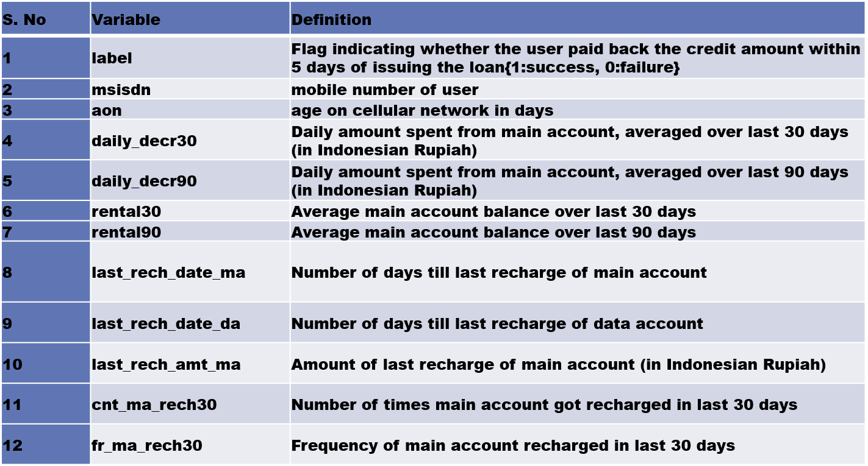
Description of Features

Slide 6
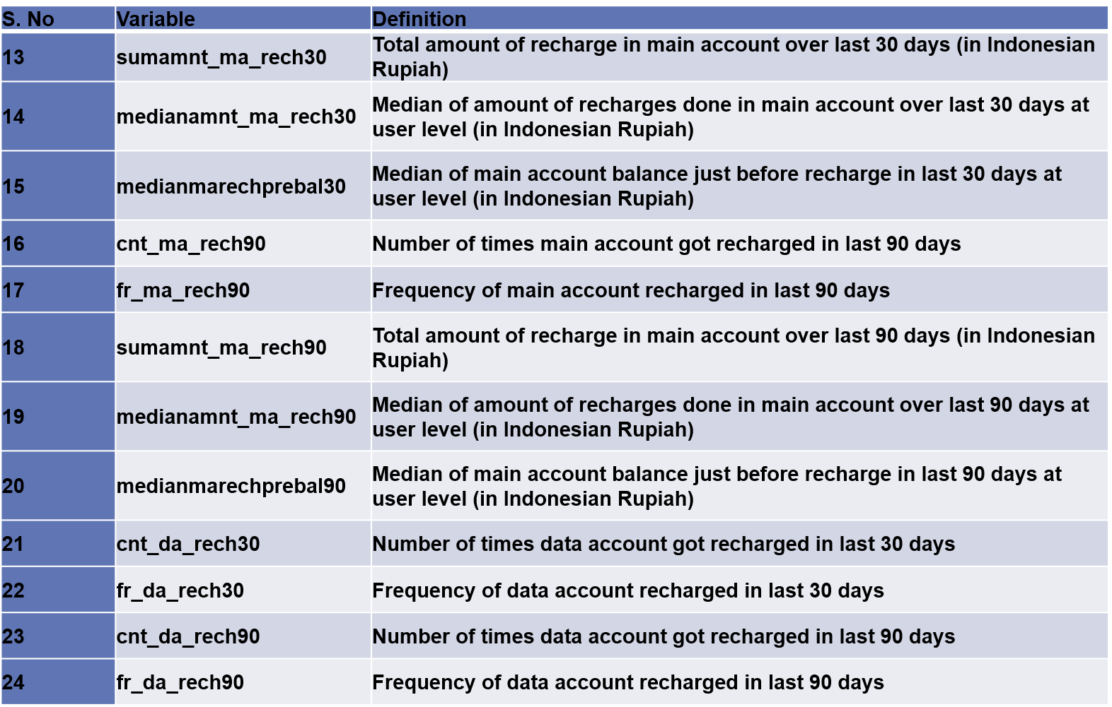
DESCRIPTION OF FEATURES

Slide 7
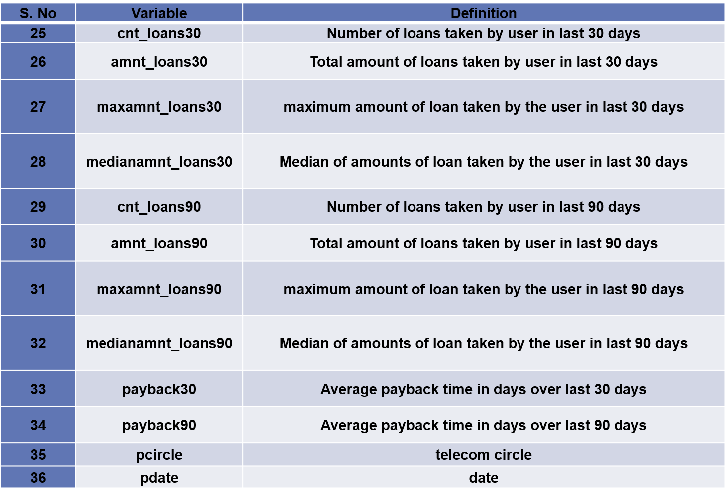
DESCRIPTION OF FEATURES

Slide 8
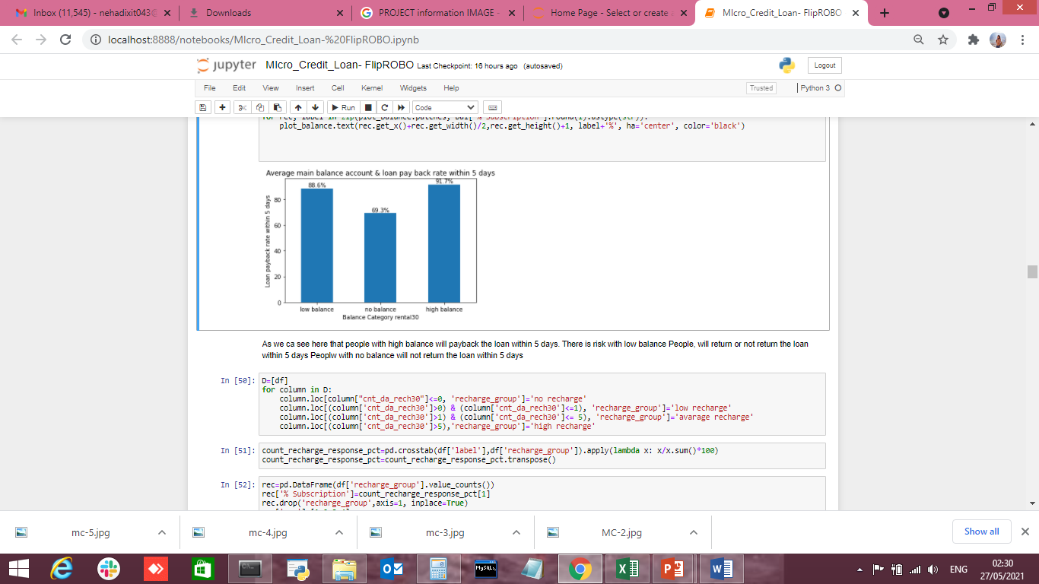
Average main balance account & loan pay back rate within 5 days
1- We can differentiate the customers with main balance levels are paying back the loan within 5 days.
2- The high balance level people are with 92% rate i.e they are paying loan within 5 days.
3- The average and low balance people ,it is observed that around 10%-15% of people are not paying the loan within 5 days.
4- It is clearly shown that around 30% of low balance level people are not paying back the loan with in stipulated 5 days of time.
5- The 30% of people with no balance or negative balance people are creating a major loss to the company without paying back the loan within 5 days of time.

Slide 9
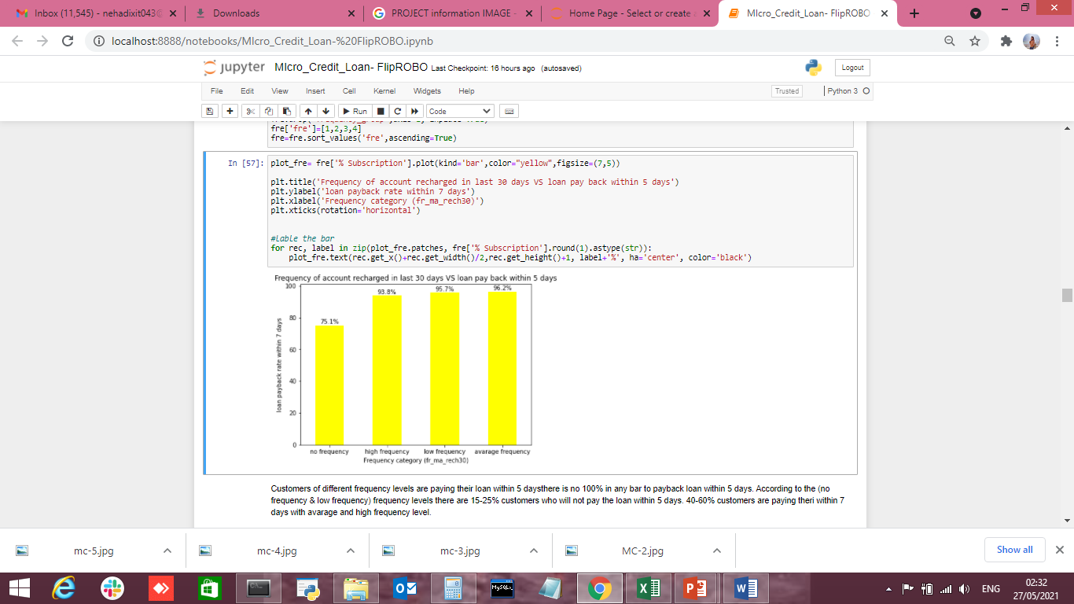
Number of frequency account recharge in last 30 days vs loan pay back rate within 7 days.
1- Customers of different frequency levels are paying their loan within 5 days.
2-there is no 100% in any bar to payback loan within 5 days.
3-According to the (no frequency & low frequency) frequency levels there are 15-25% customers who will not pay the loan within 5 days.
4-40-60% customers are paying their loan within 5 days with avarage and high frequency level.

Slide 10
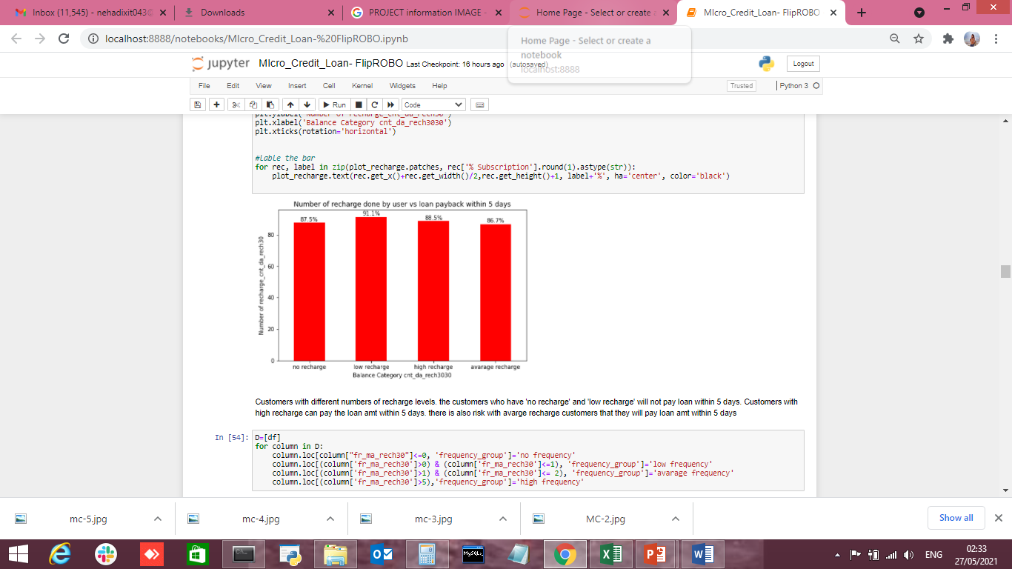
Number of recharge done by user vs loan payback within 5 days
1- Customers with different recharge levels (main account recharge) are paying back the loan within 5 days.
2- Coming to the average and low & medium frequency people it is observed that around 5%-6% of people are not paying the loan within 5 days.
3- Coming to low frequency level people, it is observed that around 35% of people are not paying back the loan with in stipulated 5 days of time.
4- The 25% people who are not getting their main account recharge for 30 days creating a major loss to the company without paying back the loan within 5 days of time.

Slide 11
What I understand from Micro-credit loan Project?
In case of subscribers or end consumers of telecom operators, this service is one step ahead of the Call Me Back feature that allows a subscriber to send a message to another subscriber to call him back in case he lacks the airtime to make the call himself.
Micro Credit on cell phone balances is very useful to customers which help in having uninterrupted communications.
Targeting the selected customer who are creditable in repaying of Micro Loans help Telecom Company a repetitive cashflow and customer satisfaction is achieved.
Communication being important part no one want to run out of balance and these leading would help in missing out the service blockages and helps in never ending customer lifetime with the brand.
Focus is on providing their services and products to low-income families and poor customers that can help them in the need of hour.

Slide 12



Steps and assumptions
Ensuring outliers are treated properly, pca will perform and dataset is ready for model testing.
X and Y variables are assigned with Independent data and Target data.
Import libraries like sk.learn linear model, Decision Tree, Random Forest Regressor and other libraries.

Slide 13
MODELS DEVELOPMENT AND EVALUATION
knc=KNeighborsClassifier()
dtc=DecisionTreeClassifier()
rfc=RandomForestClassifier()
gbc=GradientBoostingClassifier()
abc=AdaBoostClassifier()
models=[]
models.append(('LogisticRegression', lr))
models.append(('GaussianNB',gnb))
models.append(('KNeighborsClassifier',knc))
models.append(('DecisionTreeClassifier',dtc))
models.append(('RandomForestClassifier',rfc))
models.append(('GradientBoostingClassifier',gbc))
models.append(('AdaBoostClassifier',abc))
#models.append(('SVC',svc)) taking long time

Slide 14
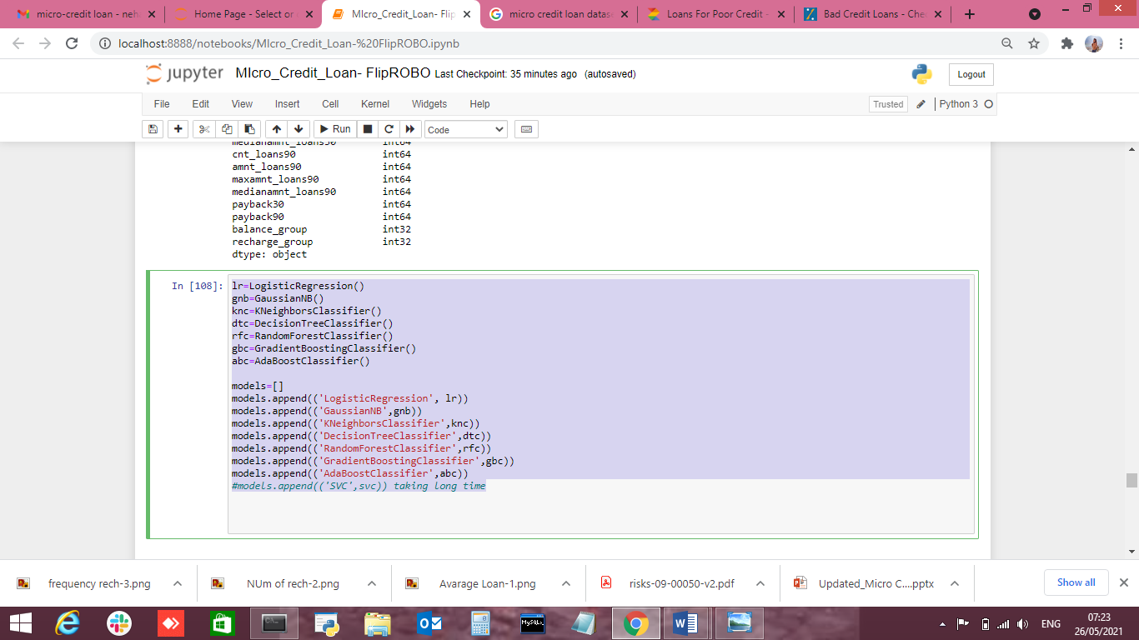
MODELS DEVELOPMENT AND EVALUATION
Run and Evaluated Selected models

Slide 15
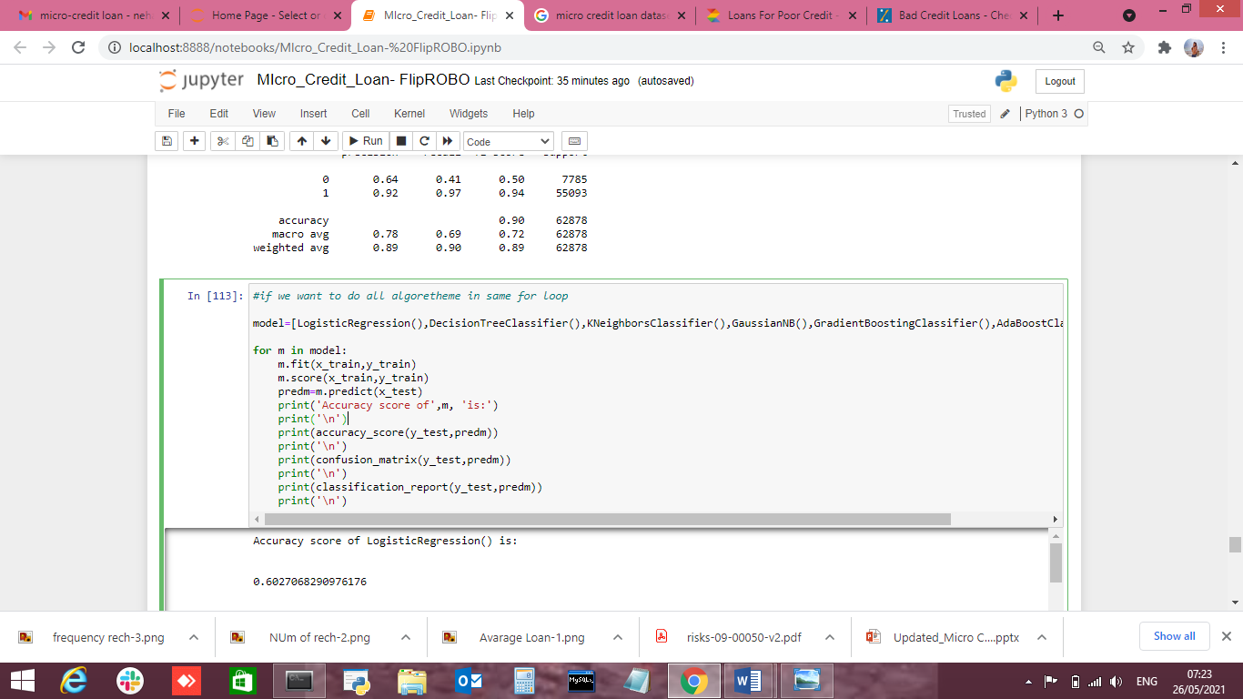
MODELS DEVELOPMENT AND EVALUATION

Slide 16
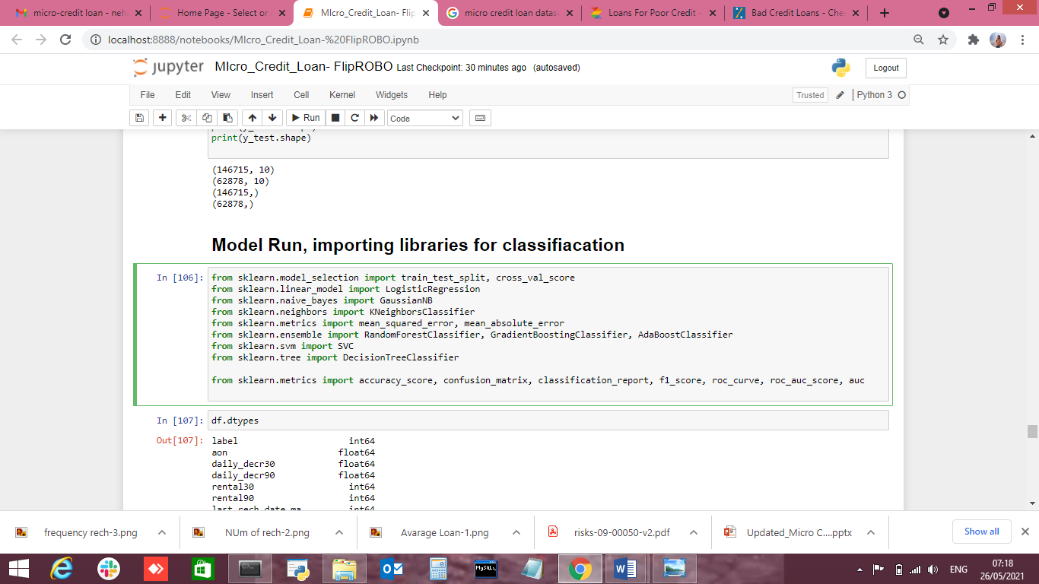
MODELS DEVELOPMENT AND EVALUATION

Slide 17
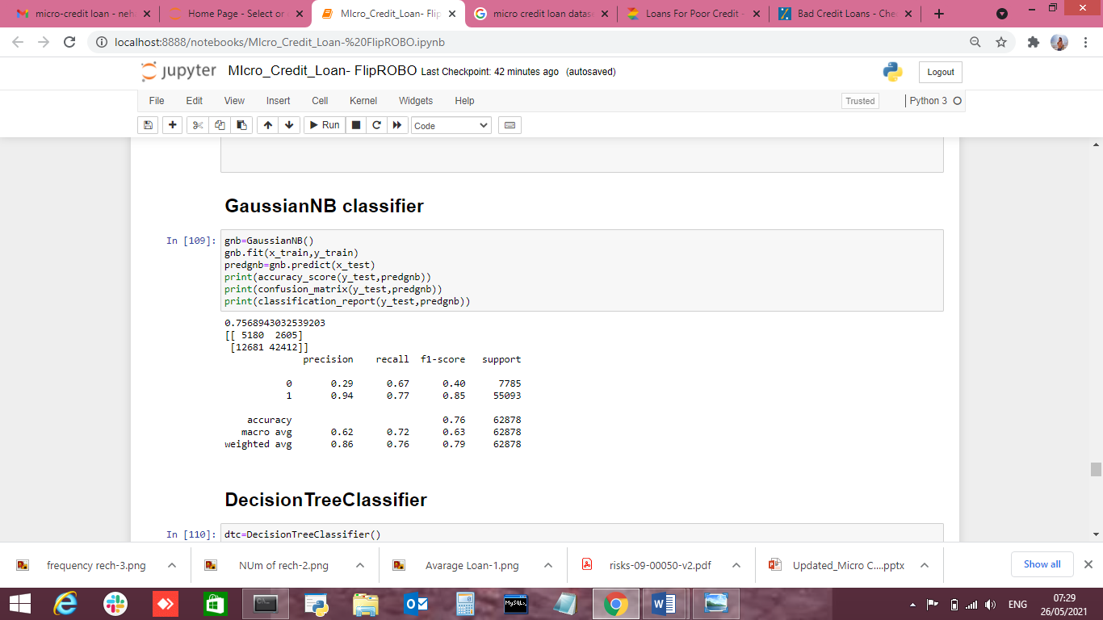
GaussianNB classifier
MODELS DEVELOPMENT AND EVALUATION

Slide 18
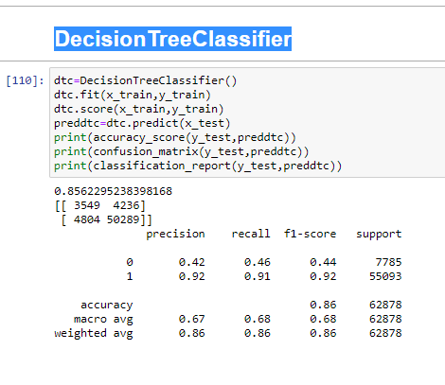
DecisionTreeClassifier
MODELS DEVELOPMENT AND EVALUATION

Slide 19
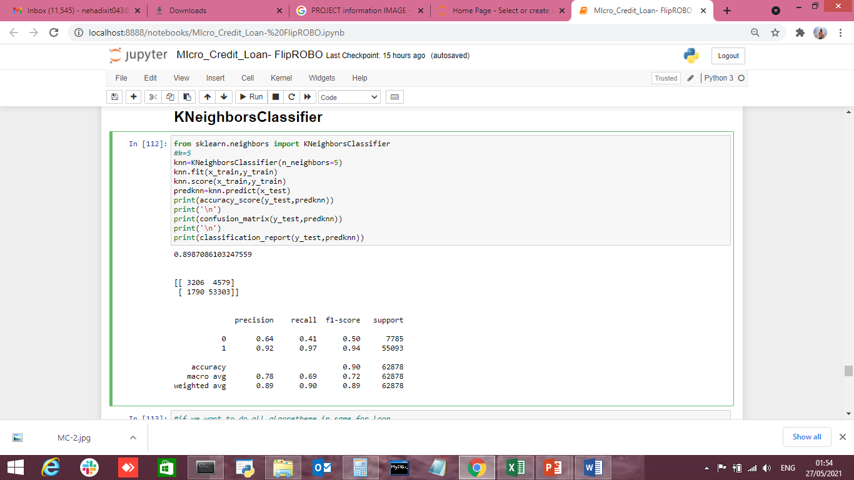
KNeighborsClassifier
MODELS DEVELOPMENT AND EVALUATION

Slide 20
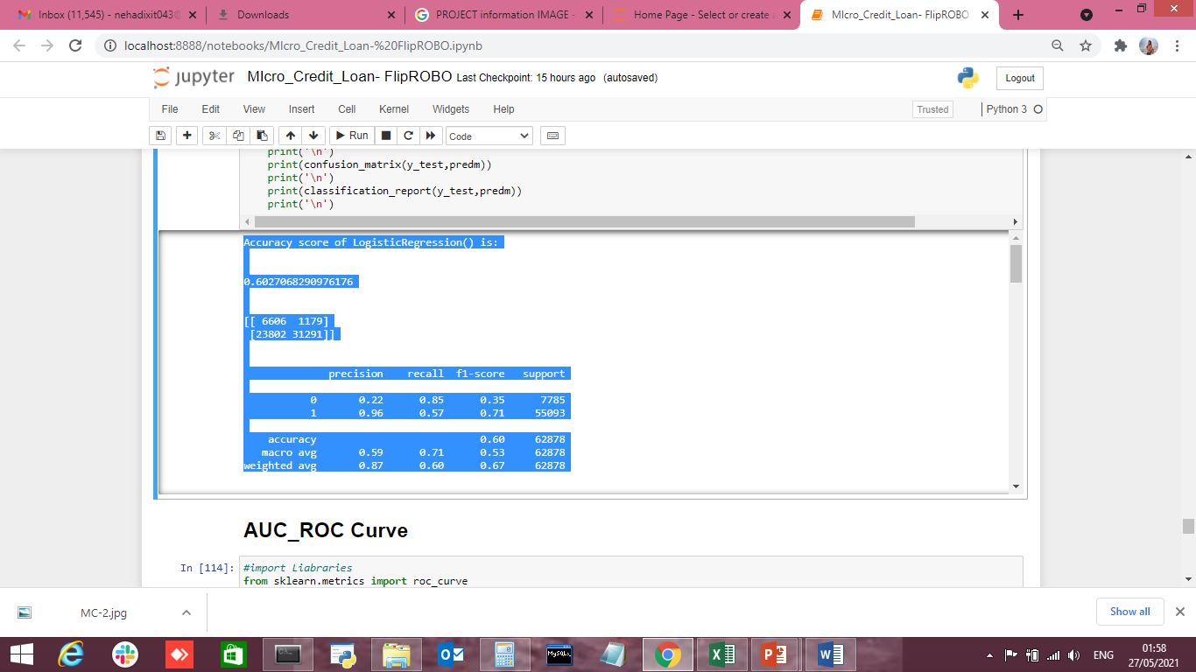
Logistic Regression classifier
MODELS DEVELOPMENT AND EVALUATION

Slide 21
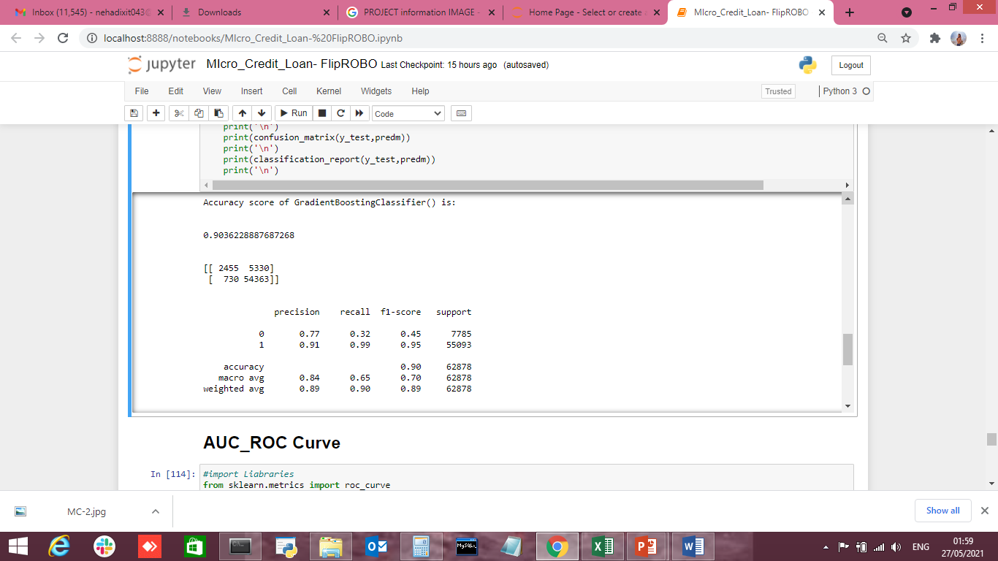
GradientBoosting Classifier
MODELS DEVELOPMENT AND EVALUATION

Slide 22
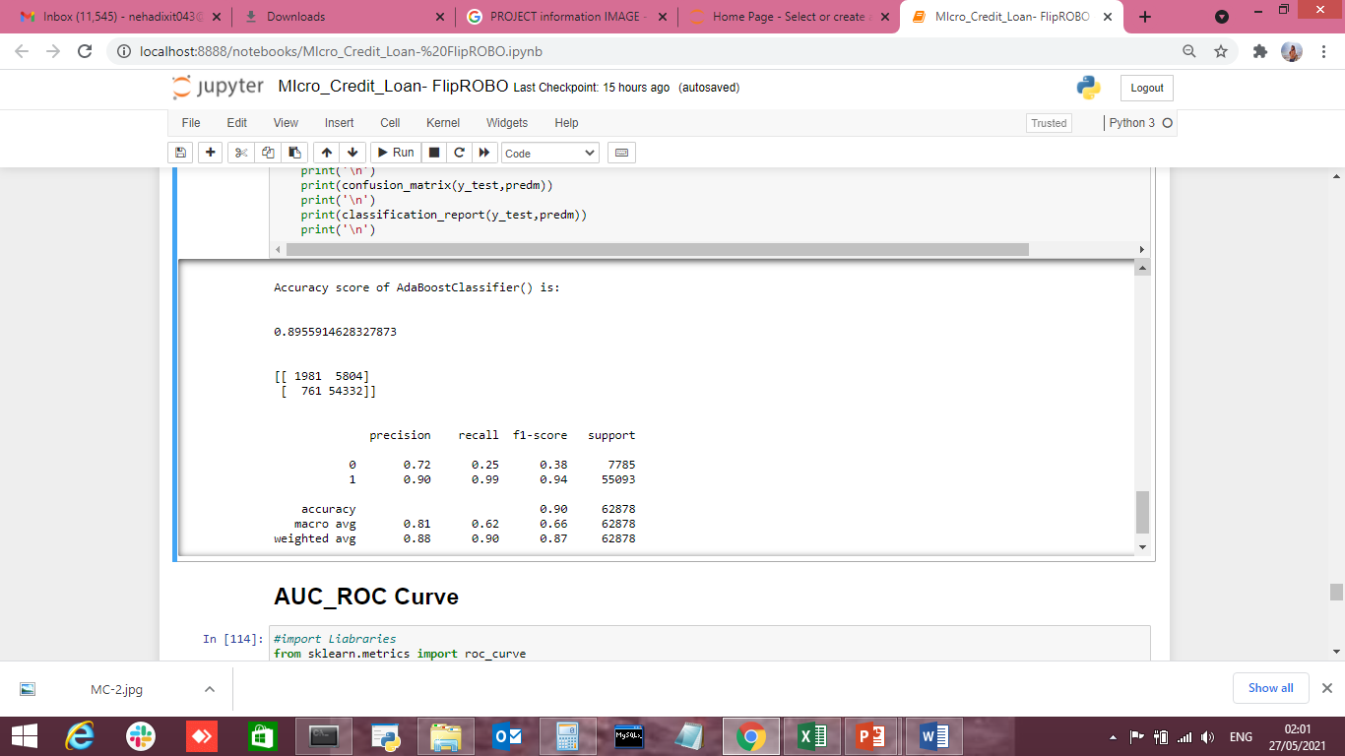
AdaBooster Classifier
MODELS DEVELOPMENT AND EVALUATION

Slide 23
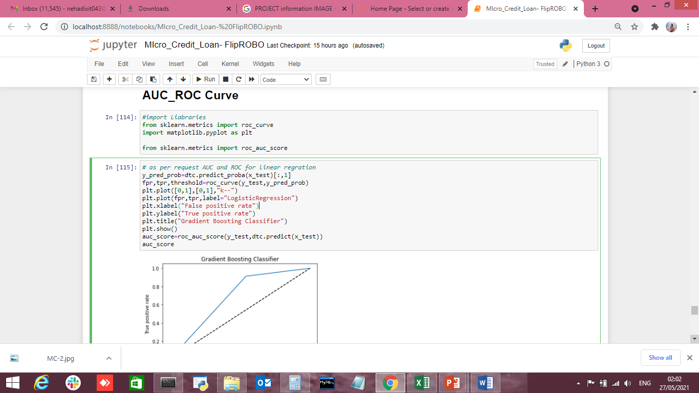
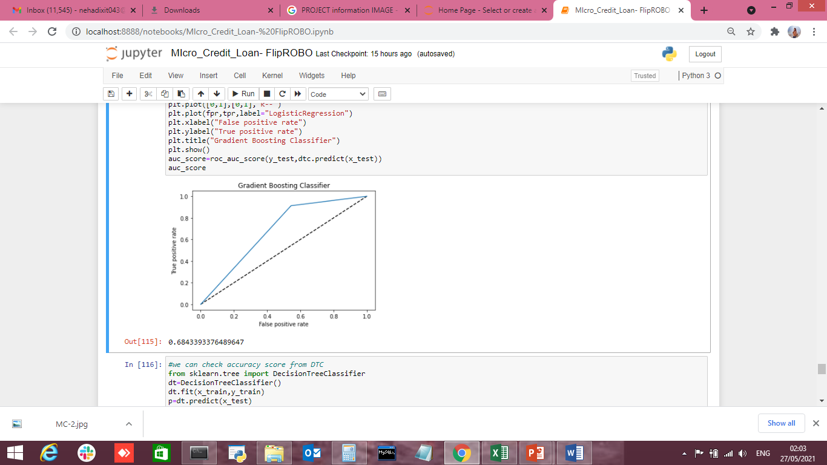
AUC_ROC Curve (False Positive Rate)

Slide 24
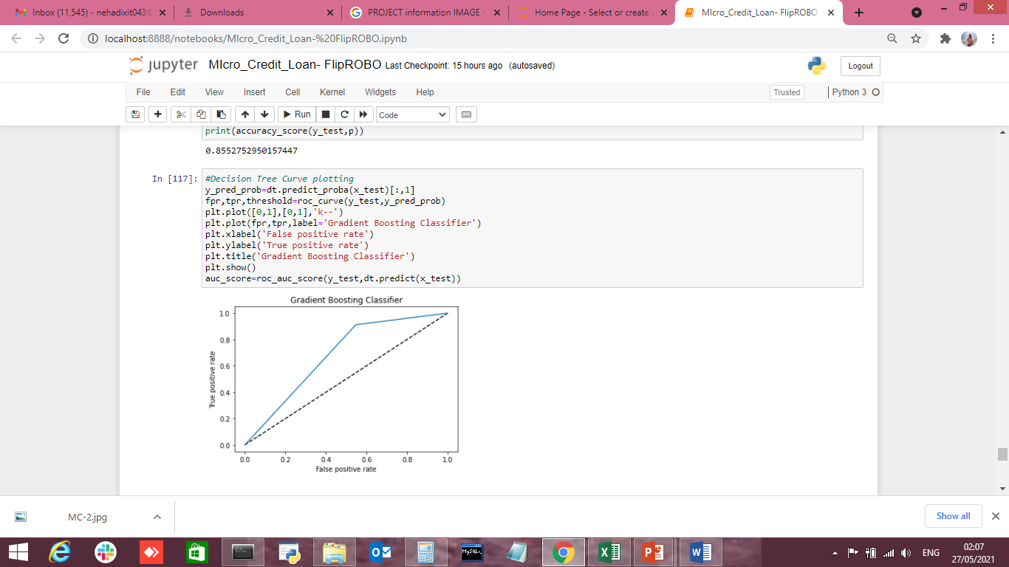
AUC_ROC Curve ( True Positive Rate)

Slide 25
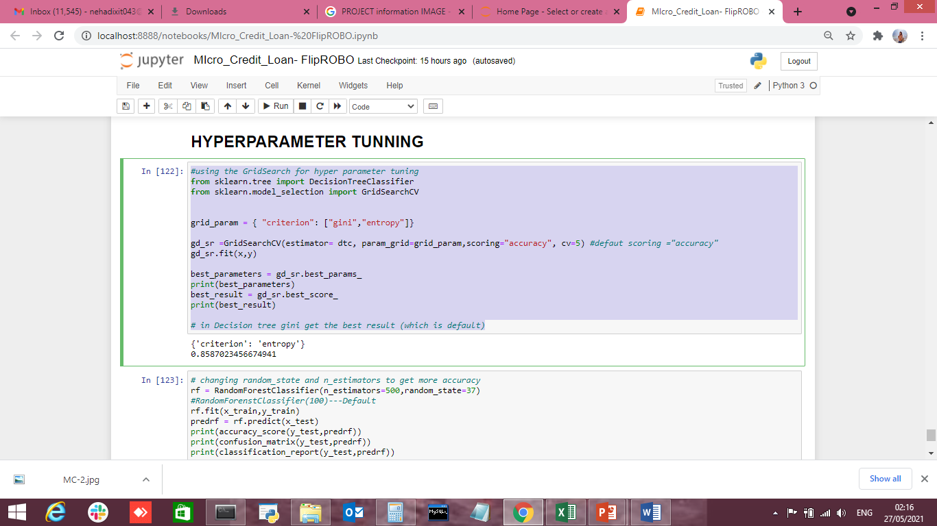
HYPERPARAMETER TUNNING
MODEL EVALUATION

Slide 26
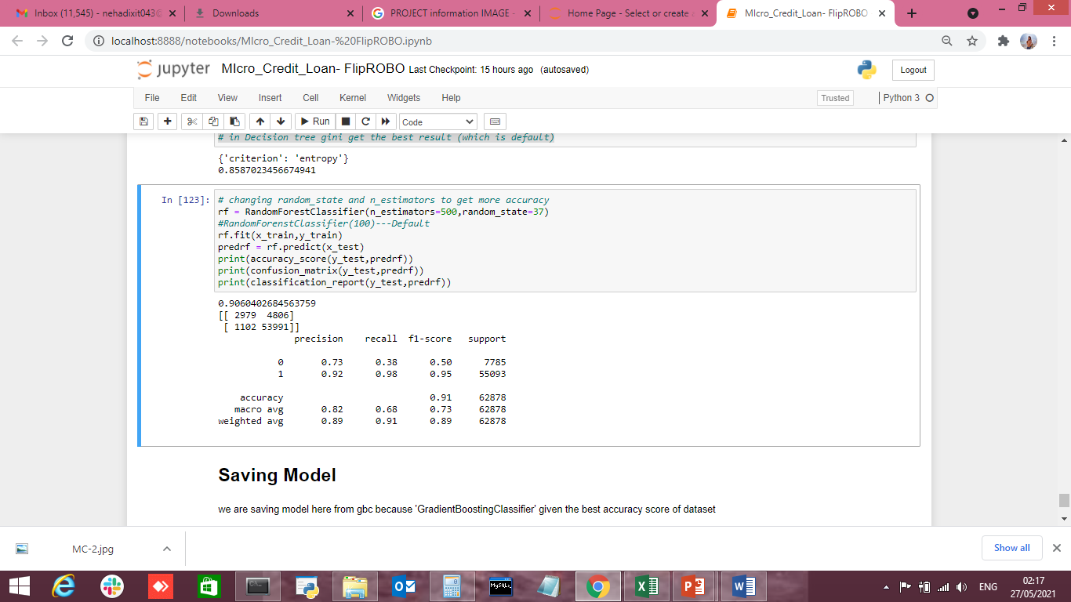
MODEL EVALUATION
HYPERPARAMETER TUNNING

Slide 27

MODEL PERFORMANCE
Having the error 0
Gradient Booster Classifier model is the best model when compare with other models.

